Slide 1
CS-A1155: Databases for Data Science 2024
DESIGNING A VOLUNTEER MATCHING SYSTEM WITH THE FINNISH RED CROSS (FRC)
Group 20- Members:
Zong-Rong Yang
Trang Le Forsell
Tien Huynh
Dung Tran

Slide 2
Content
System Design Overview/UML diagram
Free-Choice Questions
Key Insights from the Project
Challenges Encountered
Recommendations
Team Roles and Responsibilities

Slide 3
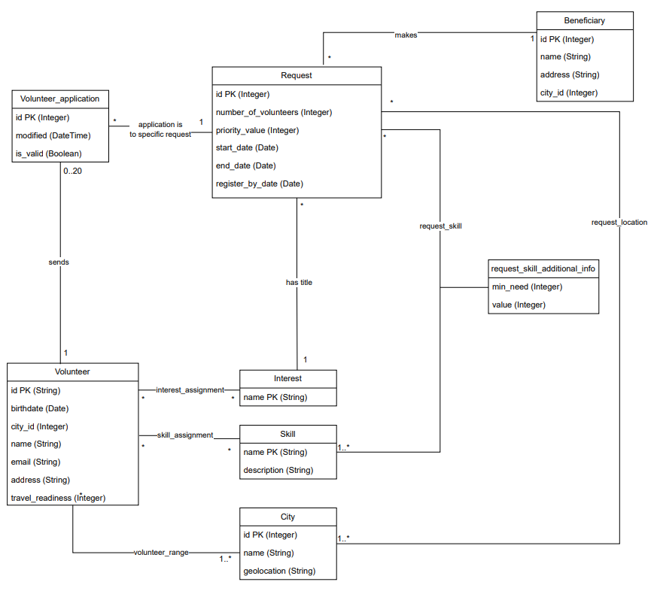
System Design Overview/UML diagram

Slide 4
Free choice question 4: Identify the most active volunteers by counting their valid application submissions and order them from most to least active.
SELECT
v.id AS volunteer_id,
v.name AS volunteer_name,
COUNT(va.id) AS valid_applications_count
FROM
volunteer_application va
JOIN
volunteer v ON va.volunteer_id = v.id
WHERE
va.is_valid = 1
GROUP BY
v.id, v.name
ORDER BY
valid_applications_count DESC;
Purpose
Identifies most active volunteers by valid applications
Enhances volunteer satisfaction and commitment
Assigns key tasks to dedicated volunteers
Improves recruitment, management, and engagement strategies

Slide 5
Free-Choice Questions –Advance-Views
View statement:
For each request, find nearest volunteers based on distance (in km) between volunteer_operating_range and request_location. Only consider distance > 0
It's reasonable to exclude volunteers whose range overlaps with the request location, as they might not add value to the selection process, skew the results and make it difficult to distinguish volunteers who genuinely need to travel to the location from those who are already nearby.
Result:
Calculate each combination of geolocation between volunteer_range and request_location. Sort and rank the result. Those with same distance get the same rank. Find the smallest distance per request.
Purpose:
Understanding the distance between volunteers and request locations can help in matching volunteers to requests more effectively
Focus on volunteers who are not in the immediate vicinity but are still nearby and potentially available for the request. This is particularly important when the existing local volunteers are insufficient to meet the request's needs.
Better plan the logistics of volunteer deployment
How to get distance in km from geolocation
Use Extension Postgis; cube or earthdistance
Haversine Formula can be used if PostGIS is unavailable, although it is less flexible and efficient
Both methods allow you to calculate distances and find the nearest points based on latitude and longitude

Slide 6
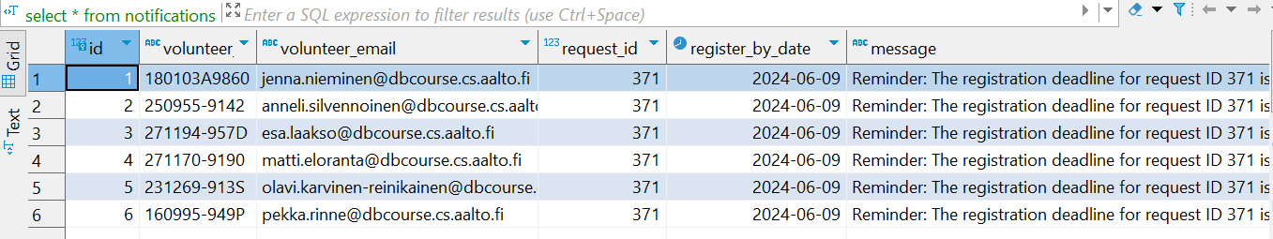
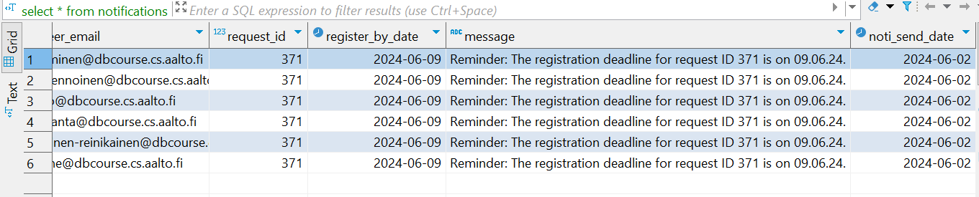
Free-Choice Questions – Advance- Transactions
Result
Purpose
Identify requests with the approaching registration deadline (‘register_by_date’) approaching within 1 week
‘Notify’ volunteers one week before the registration deadline
How: insert messages into the ‘Notifications’ table

Slide 7
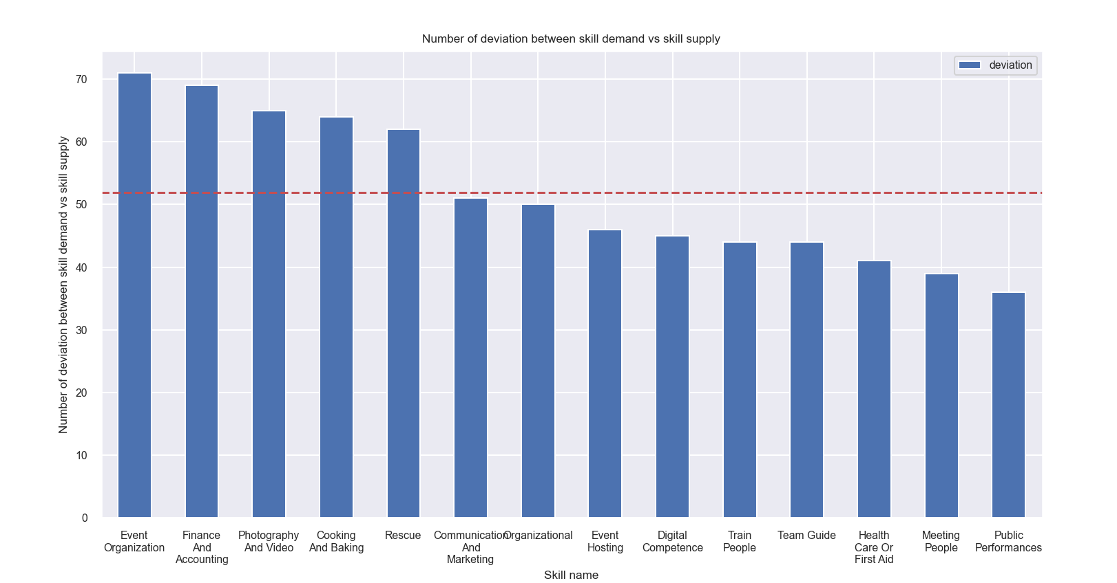
Free-Choice Questions – Advance- Analysis Identifying High-Demand, Low-Supply Skills
Purpose: to prepare resource for skills that are in high demand and low supply
Analysis: identify skills in shortage by comparing the number of volunteers with specific skills against the demand for those skills
Result

Slide 8
Key Insights learnt from the project
End-to-end workstream of database solution
The project highlighted the importance of integrating various components seamlessly from data collection to storage, ensuring robust and efficient database management
Practical case implementation
Practice apply theoretical knowledge effectively to real-world scenarios
Virtual team collaboration
Our team completed the project using various digital collaboration tools
The project completion underscored the necessity of clear and consistent communication within the virtual team

Slide 9
Challenges Encountered
The project requirements were high-level, complex and difficult to interpret, leading to misunderstandings in initial planning stages and later implementing stages.
We faced challenges due to knowledge gap in designing a scalable database solution. This impacted our ability to accommodate growing data volumes while maintaining optimal performance.

Slide 10
Suggestions
We recommend replacing geolocation with zip code for increased granularity.
This change allows us to split large cities into smaller sections, making travel times more manageable for volunteers. Geolocations can be converted to zip codes using Google Maps API or publicly available bounding box data.
We recommend creating synthetic IDs for volunteer IDs to ensure compliance and protect personal data.
Using personal security numbers (SSNs) as primary keys as in current design violates GDPR regulations, article 4.
Source: https://gdpr-info.eu/art-4-gdpr/

Slide 11
Team Roles and Responsibilities
Task name | In charge
UML finalizes and update documentation | Dung Tran
Create tables into database | Zong-Rong Yang
Load data from Excel file to database | Trang Le Forsell and Tien Huynh
Data pre-processing and cleaning | Tien Huynh
Basic queries | Tien Huynh, Dung Tran, and Zong-Rong Yang
Advance queries | Tien Huynh and Dung Tran
Transactions | Dung Tran
Data analysis | Trang Le Forsell
Update final report | Dung Tran
Presentation slides | Trang Le Forsell
Team collaboration:
Equally divided workload based on interests and strengths
Each member led and finalized specific tasks
All members contributed and provided support throughout the process

Slide 13
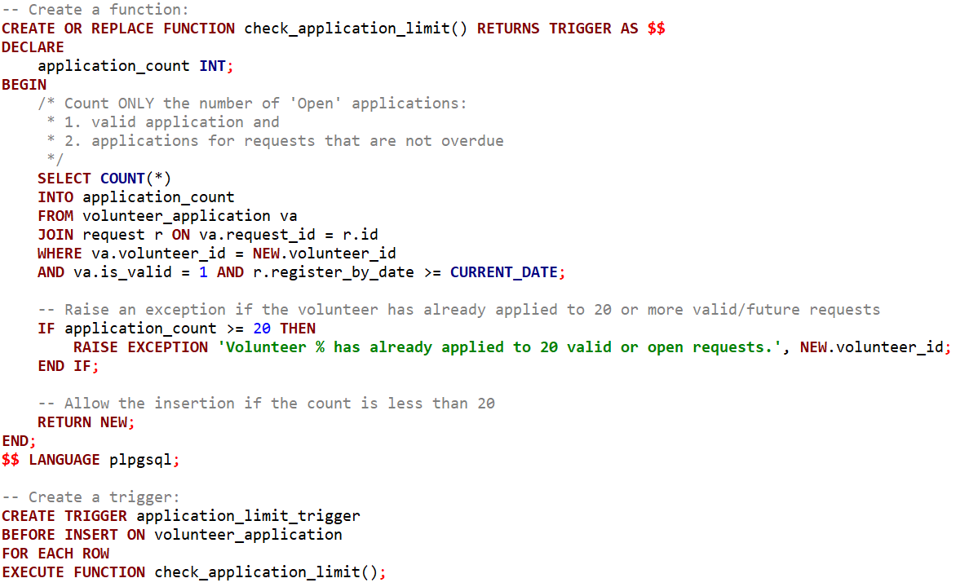
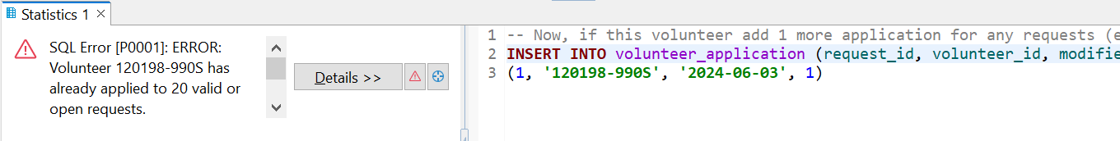
Appendix - Additional trigger 1/2 (Dung)
Trigger 1: Check ‘Volunteers can apply up to 20 open application’ requirement
Definition of ‘Open’ application:
Valid application: ‘is_valid’ = True
Current request: register_by_date is not past
‘Alert’ message:

Slide 14
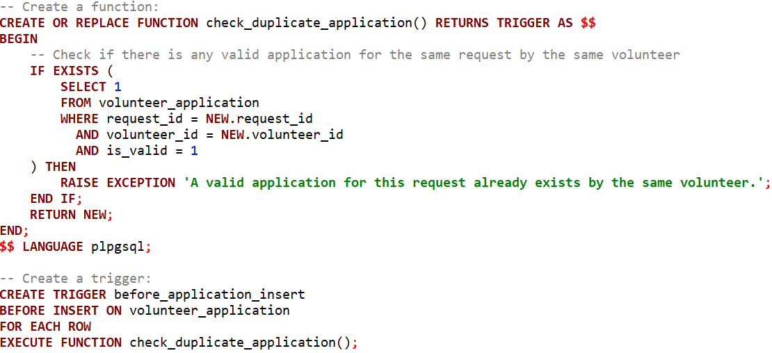
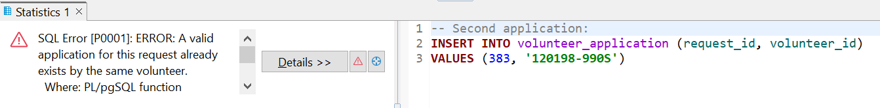
Appendix - Additional trigger 2/2 (Dung)
Trigger 2: Prevent duplicate applications for the same request
The trigger is launched when the volunteer is currently having the valid application for the same request.
‘Alert’ message:

